Slide 1
Algorithms – I (CS21203)
Autumn 2023, IIT Kharagpur
Graphs

Slide 2
Resources
Apart from the book
UC Davis ECS 36C Course by Prof. Joël Porquet-Lupine
UC Riverside, CS 141 course, Fall 2021 by Prof. Yan Gu and Prof. Yihan Sun

Slide 3

Introduction - Seven Bridges of Königsberg
Context
Paper published by Leonhard Euler in 1736
Regarded as first in history of graph theory
Problem
City of Königsberg in old Prussia
Split in four pieces: 2 mainland portions and 2 islands
Interconnected by 7 bridges
Problem: is it possible to walk through the city, crossing each bridge once and only once?
Euler proved that the problem had no solution
Developed new technique of analysis to support his proof
Know Euler - Very interesting talk (must see if you ask me) - Link
Source: UC Davis, ECS 36C course, Spring 2020
Image is taken from wikipedia

Slide 4
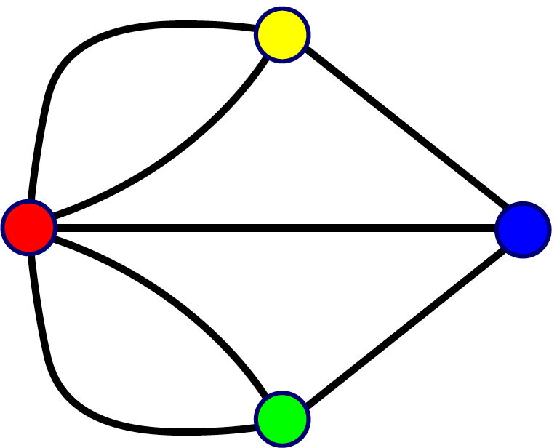
Introduction - Seven Bridges of Königsberg
Representation
Reformulated the problem in abstract termsRegarded as first in history of
Land mass: vertex (or node)
Bridge: edge
Resulting representation is a graph
Analysis
Need graph to be connected
Possibility of a walk depends on the degrees of the nodes
Source: UC Davis, ECS 36C course, Spring 2020

Slide 5
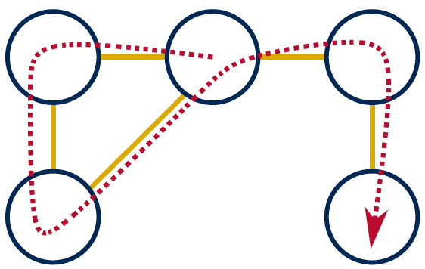
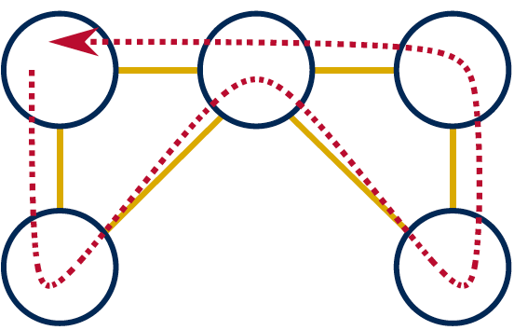
Introduction - Seven Bridges of Königsberg
Euler’s proposals
Eulerian path
Aka Euler walk
Path traversing all edges exactly once
Only possible if graph has exactly zero or two nodes of odd degree
If two nodes of odd degree: start path at one and end at the other
Eulerian circuit
Aka Euler tour
Path traversing all edges with same start and end point
Only possible if all nodes are of even degree
Source: UC Davis, ECS 36C course, Spring 2020

Slide 6
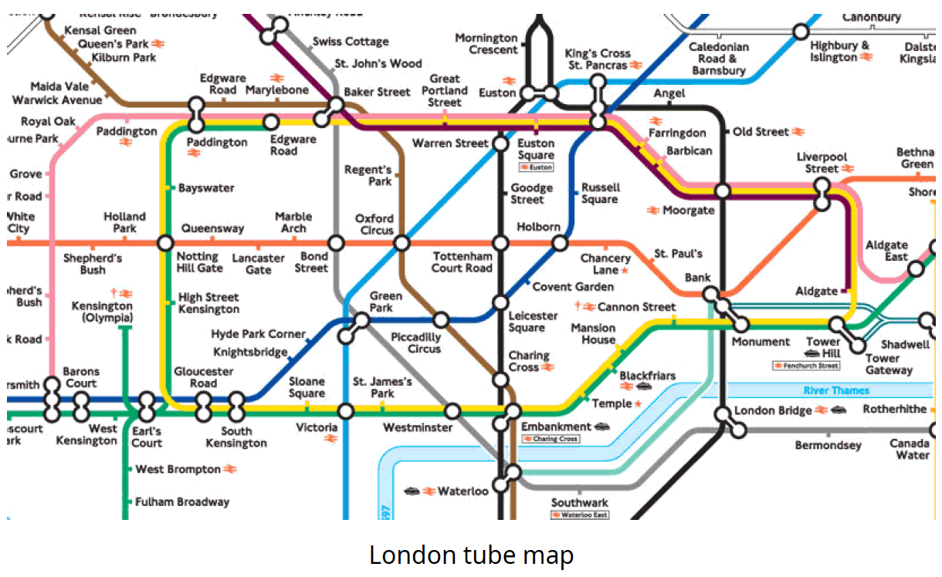
Introduction - Graphs
Set of vertices connected pairwise by edges
Extremely versatile, apply to thousands of practical applications
Many known algorithms to manipulate graphs
Examples - Subway map
Source: UC Davis, ECS 36C course, Spring 2020

Slide 7
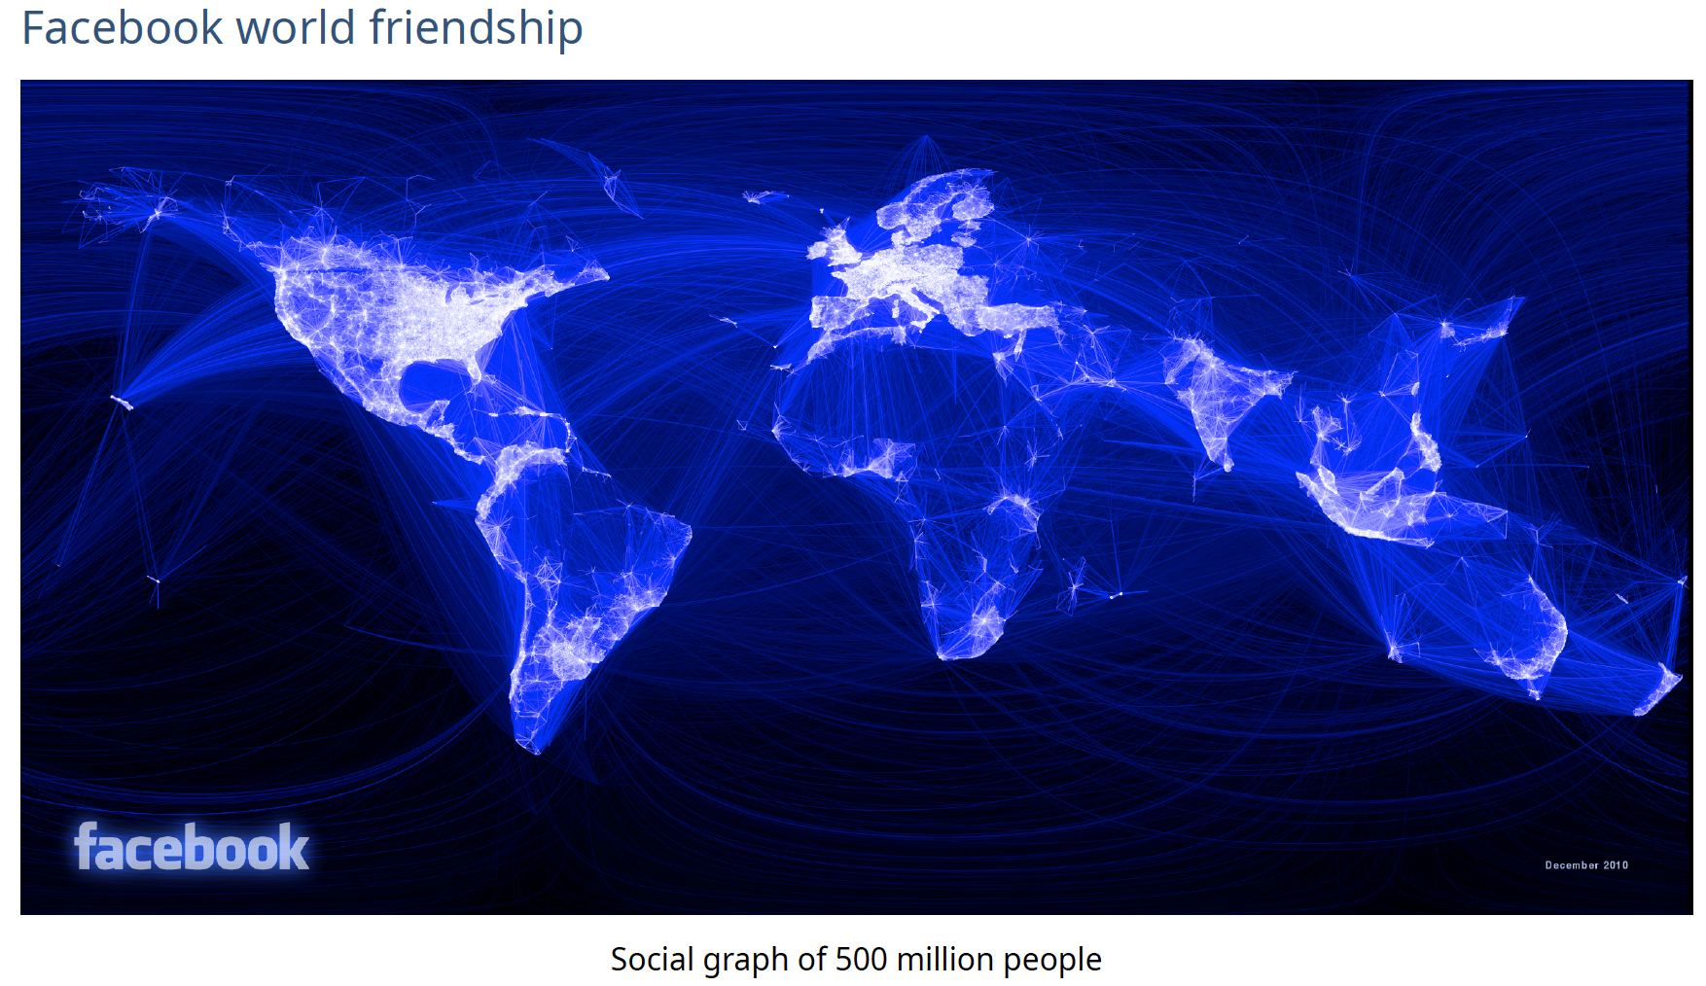
Introduction - Graphs
Examples – Facebook World Friendship Map
Source: UC Davis, ECS 36C course, Spring 2020

Slide 8
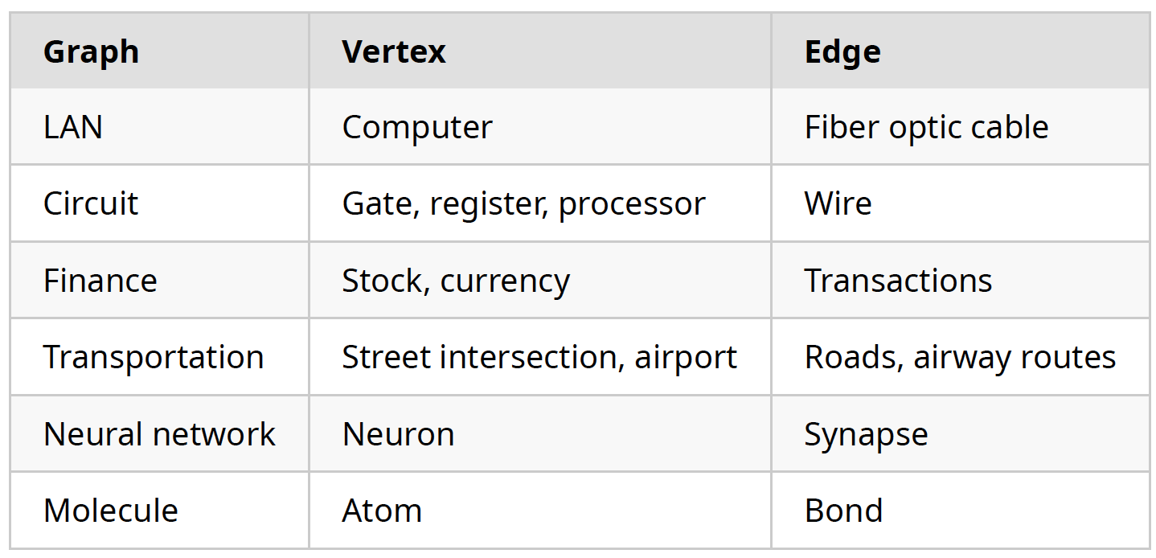
Introduction - Graphs
Other application examples
Source: UC Davis, ECS 36C course, Spring 2020

Slide 9
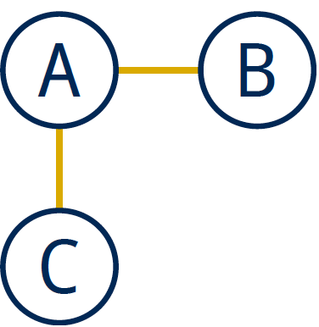
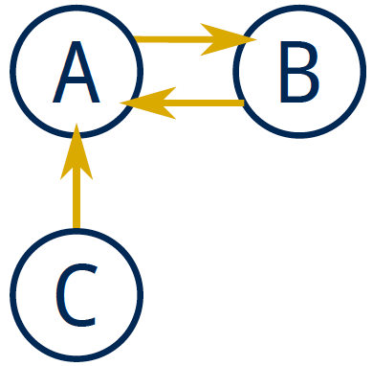
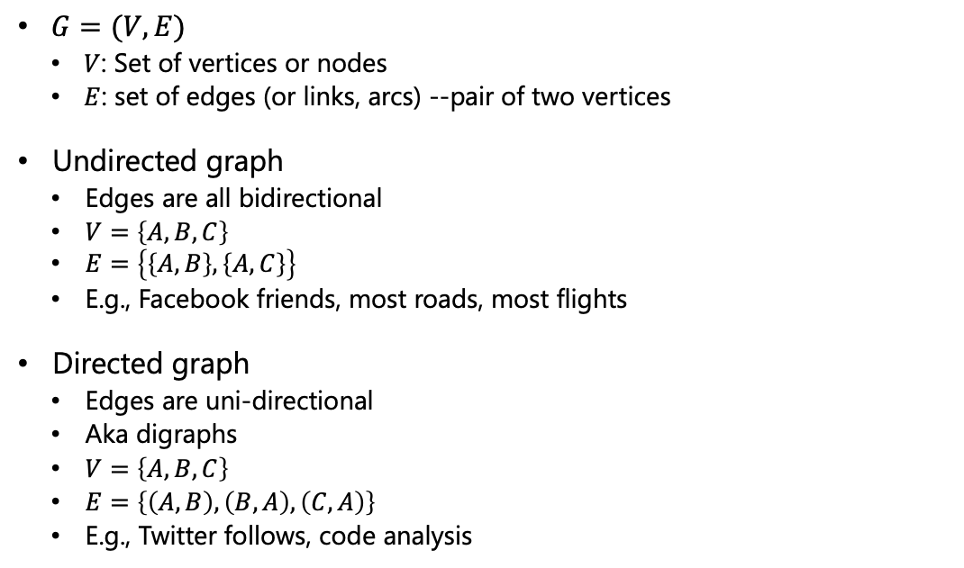
Graphs - Definitions
$G=(V, E)$
$V$: Set of vertices or nodes
$E$: set of edges (or links, arcs) --pair of two vertices
Undirected graph
Edges are all bidirectional
$V=\left\{A, B, C\right\}$
$E=\left\{\left\{A, B\right\}, \left\{A, C\right\}\right\}$
E.g., Facebook friends, most roads, most flights
Directed graph
Edges are uni-directional
Aka digraphs
$V=\left\{A, B, C\right\}$
$E=\left\{\left(A, B\right), \left(B, A\right), \left(C, A\right)\right\}$
E.g., Twitter follows, code analysis
Source: UC Davis, ECS 36C course, Spring 2020

Slide 10
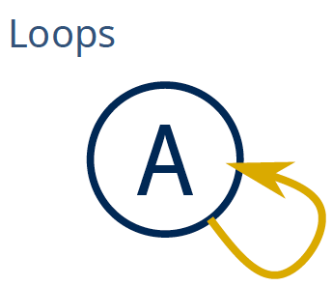
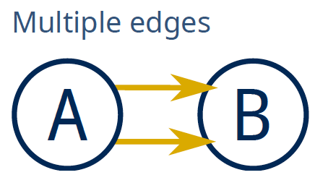
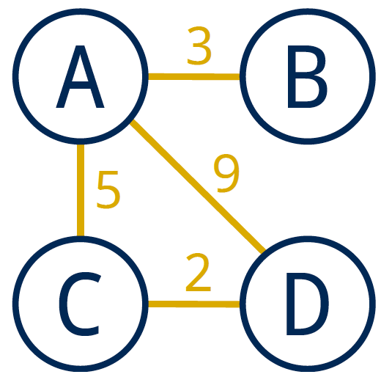
Graphs - Definitions
Multigraph
A multigraph is a graph (directed or not) in which multiple edges and loops are allowed
Simple graph
A simple graph is an undirected graph which has neither multiple edges nor loops
Default definition of a graph
Weighted graph
In a weighted graph, each edge is associated with a weight
Weights usually represent costs, lengths, capacities, etc.
Depends on the problem at hand
Source: UC Davis, ECS 36C course, Spring 2020

Slide 11
Graphs - Definitions
Degree of a vertex
Number of edges incident on vertex
Only relevant for digraphs:
In-degree: number of edges incident to vertex
Out-degree: number of edges incident from vertex
0-degree vertices
All these graphs are valid
A
B
C
A
B
A
B
A
B
C
C
C
C: in-degree of 0
B: out-degree of 0
C: degree of 0
Source: UC Davis, ECS 36C course, Spring 2020

Slide 12
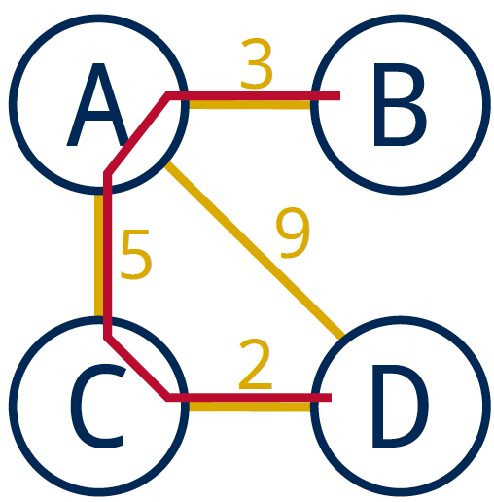
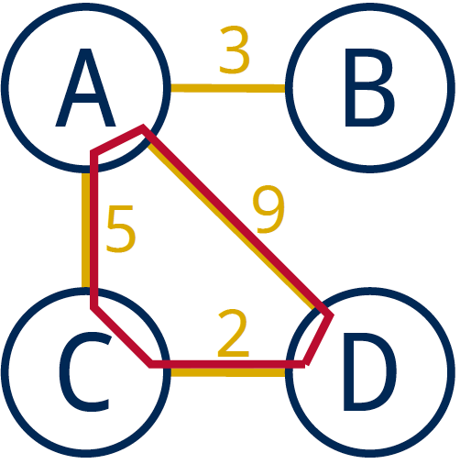
Graphs - Definitions
Path
Sequence of vertices connected by edges
Length: number of edges along the path
Weight: sum of all edge weights along the path
Cycle
Path whose first and last vertices are the same
A graph containing no cycles is said to be acyclic
Source: UC Davis, ECS 36C course, Spring 2020

Slide 13
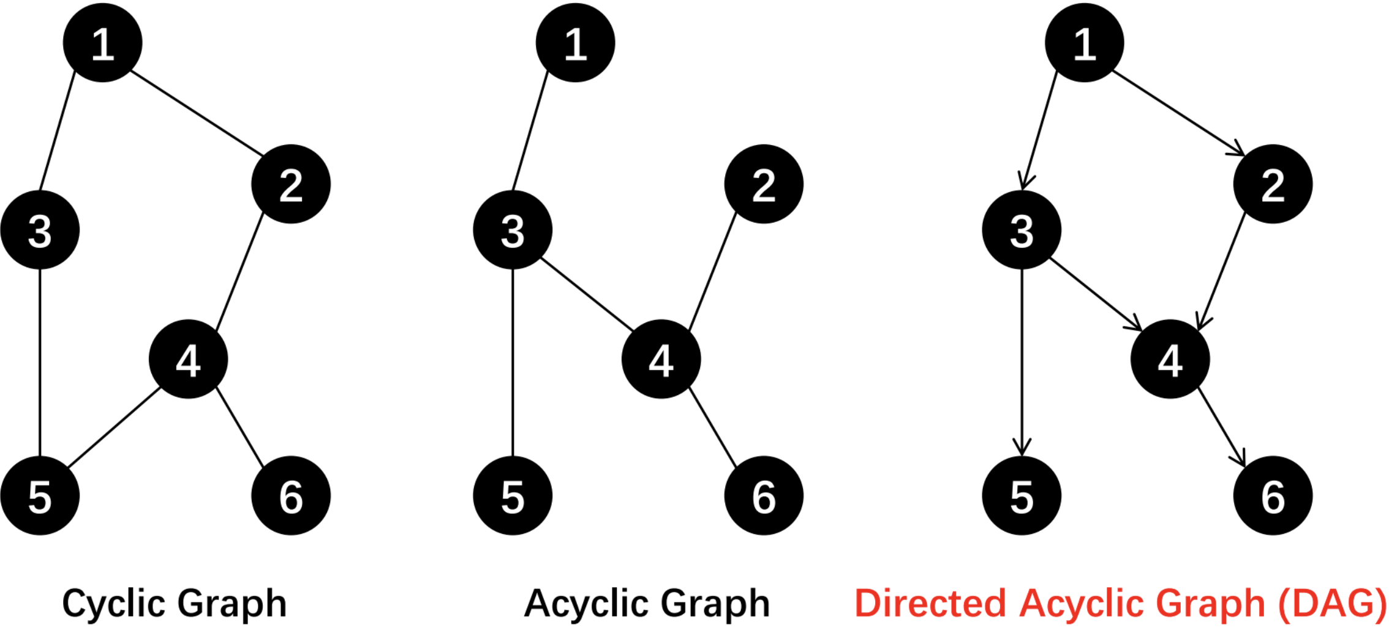
Graphs - Definitions
Source: UC Riverside, CS141 course, Fall 2021

Slide 14
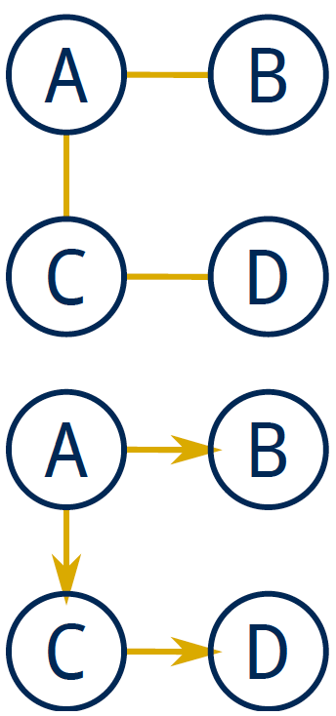
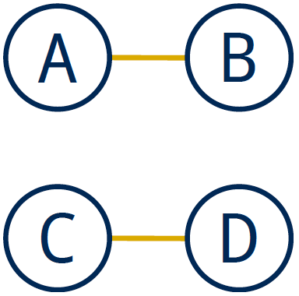
Graphs - Definitions
Connected graph
Vertices are connected if there is a path between them
For directed graphs
Strongly connected if directed path between two vertices
Weakly connected otherwise
A connected graph is a graph in which every pair of vertices are connected
If every pair of vertices is joined by an edge, the graph is complete or fully-connected
Disconnected graph
A disconnected graph is composed of two or more connected components
Source: UC Davis, ECS 36C course, Spring 2020

Slide 15
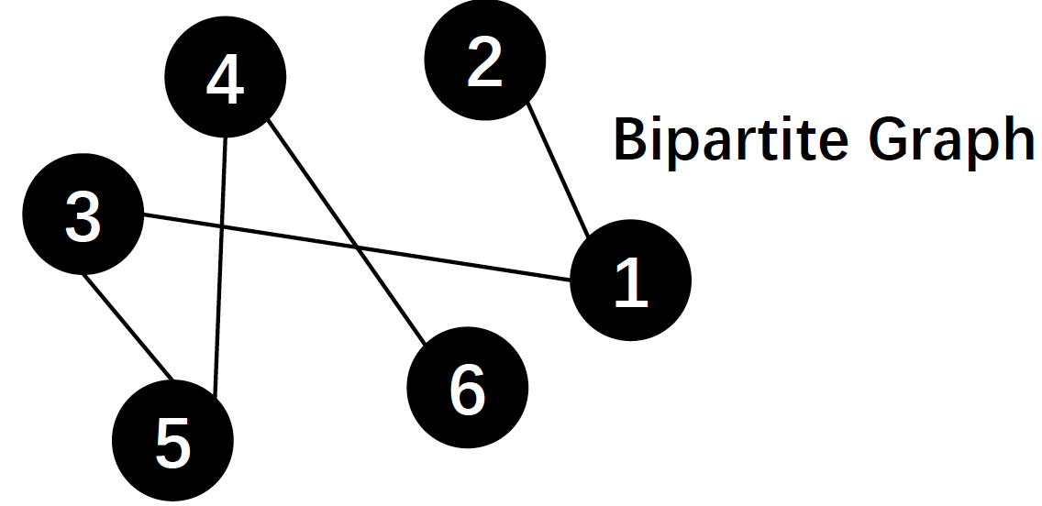
Graphs - Definitions
Bipartite graph
A graph where the vertices can be partitioned into two subsets:
no edges within a subset and all the edges are between two subsets
Usually, vertices in two subsets have different meanings
E.g., students and courses, courses and classrooms, jobs and applicants
Source: UC Riverside, CS141 course, Fall 2021

Slide 16
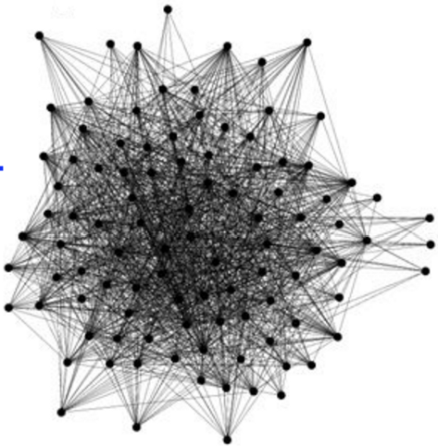
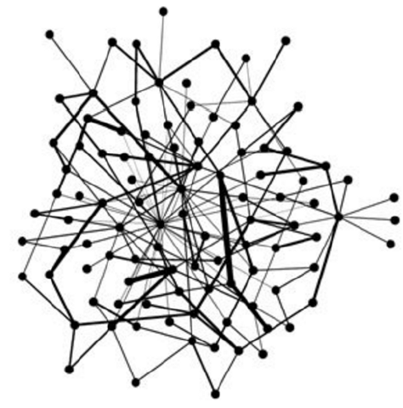
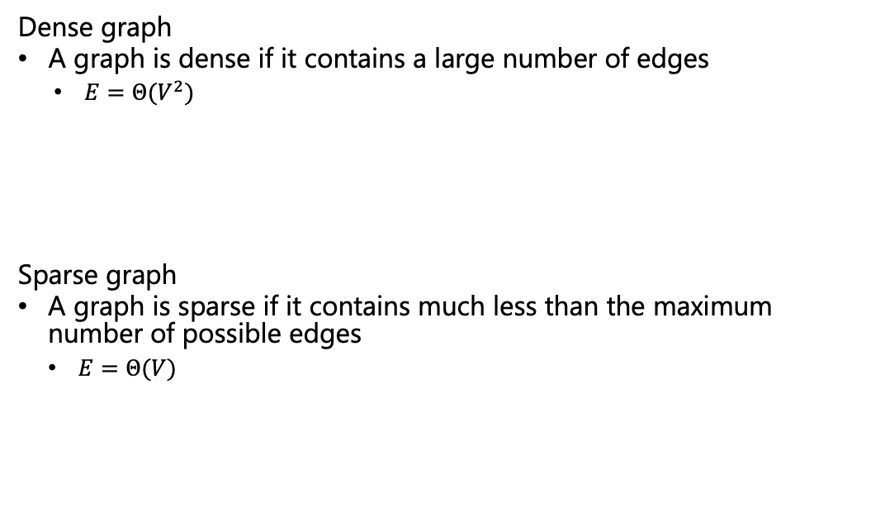
Graphs - Definitions
Dense graph
A graph is dense if it contains a large number of edges
$E=Θ(V^{2})$
Sparse graph
A graph is sparse if it contains much less than the maximum number of possible edges
$E=Θ(V)$
Source: UC Davis, ECS 36C course, Spring 2020

Slide 17
Trees
Trees are a specific kind of graph too!
Undirected, acyclic, connected, rooted graph
A forest is a graph in which multiple connected components are trees
A
B
C
D
E
F
G
H
I
J
K
Source: UC Davis, ECS 36C course, Spring 2020

Slide 18
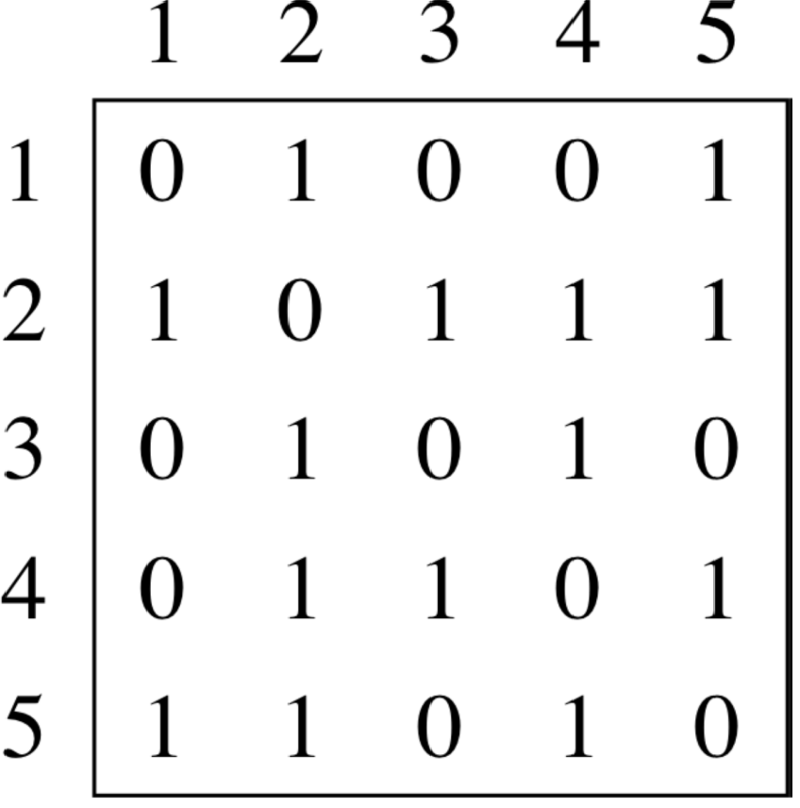
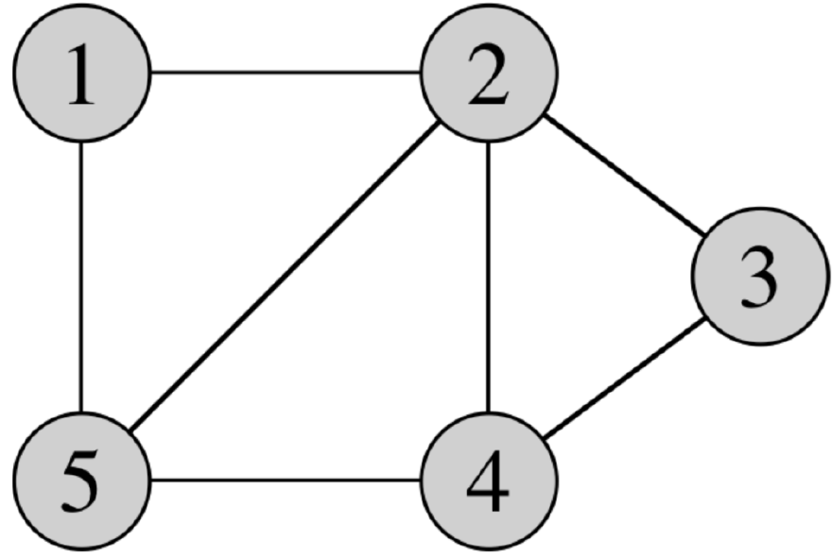
Graph Representations
Adjacency matrix
Source: UC Riverside, CS141 course, Fall 2021

Slide 19
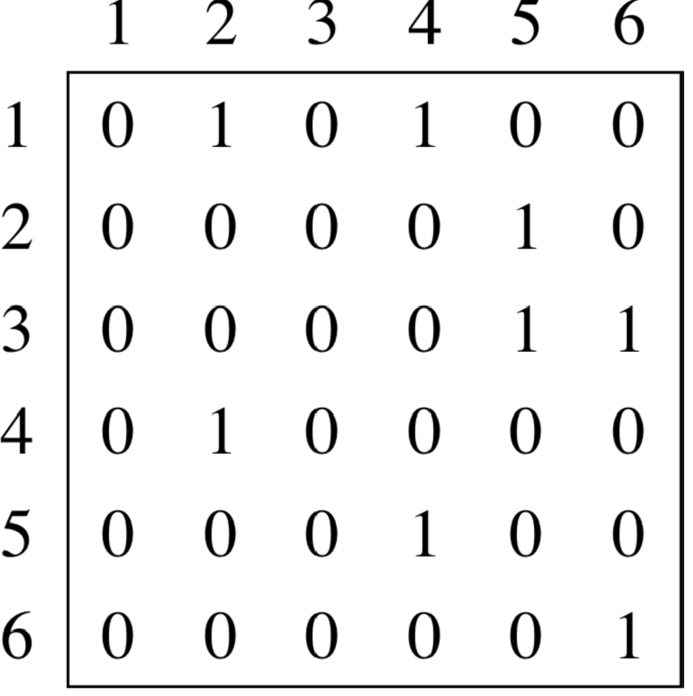
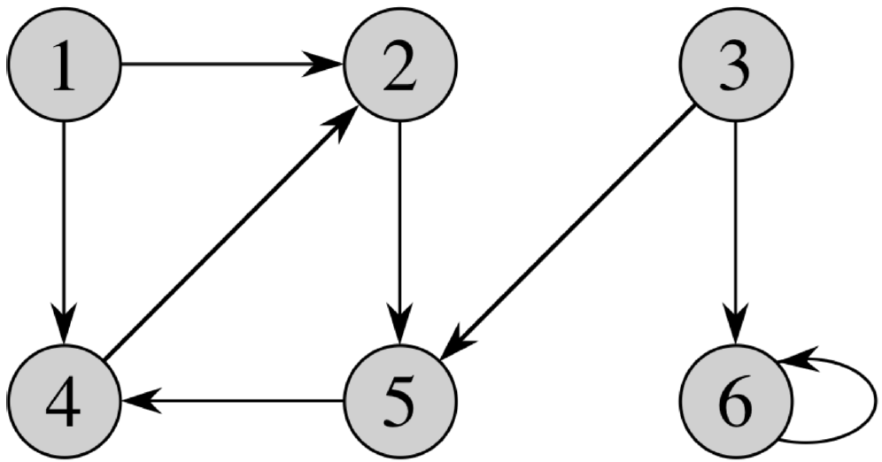
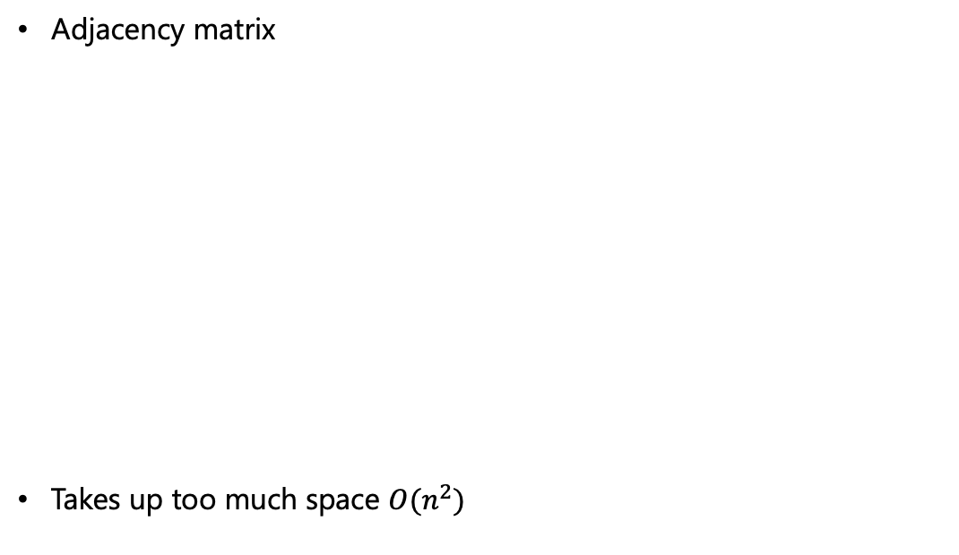
Graph Representations
Adjacency matrix
Takes up too much space $O(n^{2})$
Source: UC Riverside, CS141 course, Fall 2021

Slide 20
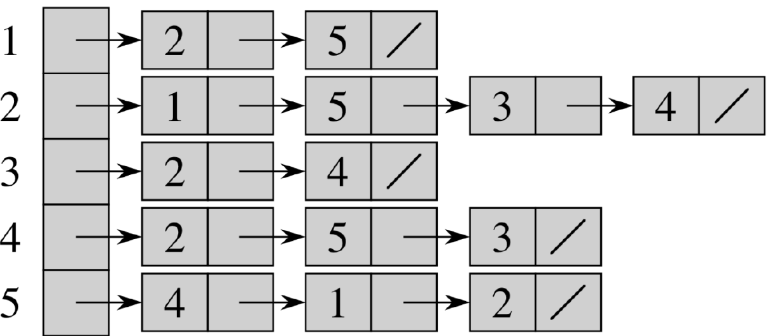
Graph Representations
Adjacency list
Source: UC Riverside, CS141 course, Fall 2021

Slide 21
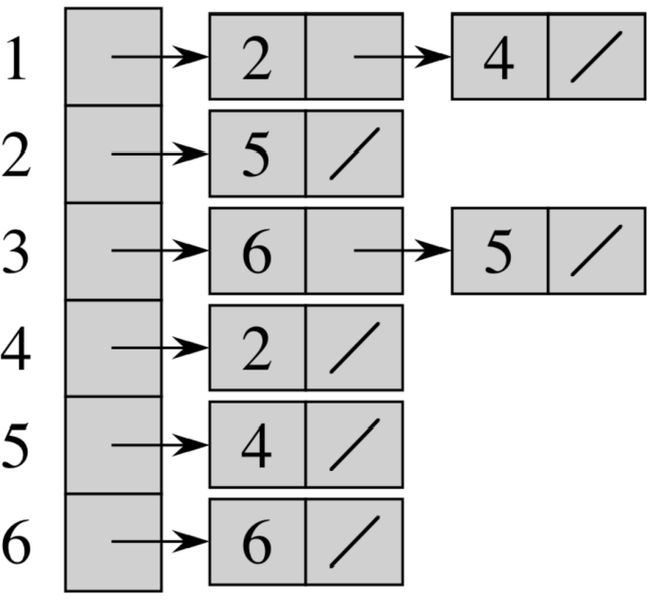
Graph Representations
Adjacency list
What do scientists use in practice?
Source: UC Riverside, CS141 course, Fall 2021

Slide 22
Graph Traversal/Search
Graph traversals or searches mean systematic following edges of a graph so as to visit all the vertices of the graph
Graph-searching algorithm can discover much about the structure of a graph
Many graph algorithms begins by building on basic graph searching
We will start with two basic graph search algorithms
Breadth First Search (BFS)
Depth First Search (DFS)
We will assume adjacency list representation for today’s algorithms

Slide 23
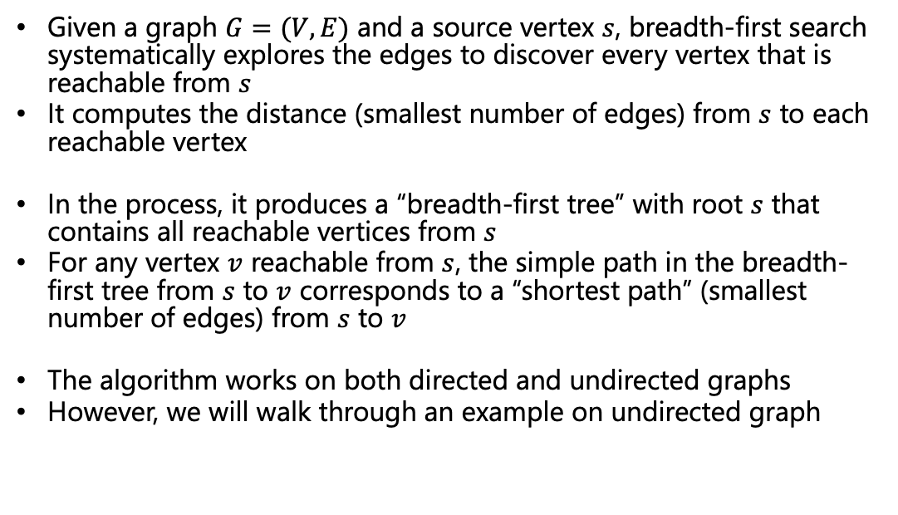
Breadth First Search
Given a graph $G=(V, E)$ and a source vertex $s$, breadth-first search systematically explores the edges to discover every vertex that is reachable from $s$
It computes the distance (smallest number of edges) from $s$ to each reachable vertex
In the process, it produces a “breadth-first tree” with root $s$ that contains all reachable vertices from $s$
For any vertex $v$ reachable from $s$, the simple path in the breadth-first tree from $s$ to $v$ corresponds to a “shortest path” (smallest number of edges) from $s$ to $v$
The algorithm works on both directed and undirected graphs
However, we will walk through an example on undirected graph

Slide 24

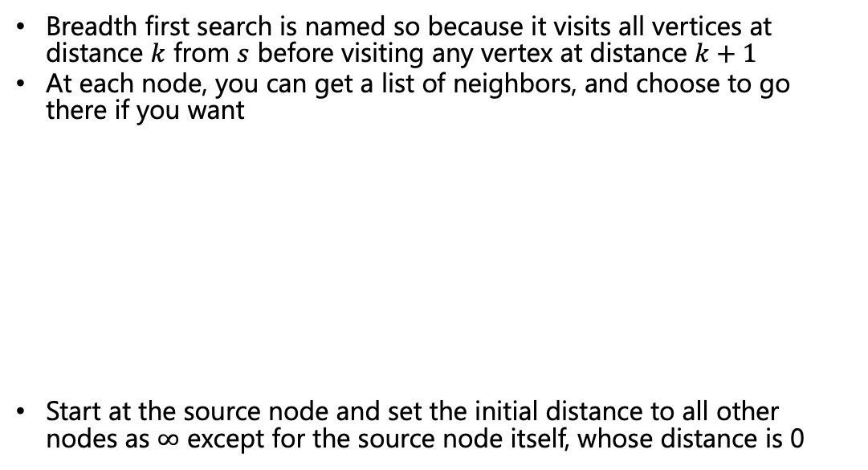




Breadth First Search
Breadth first search is named so because it visits all vertices at distance $k$ from $s$ before visiting any vertex at distance $k+1$
At each node, you can get a list of neighbors, and choose to go there if you want
Start at the source node and set the initial distance to all other nodes as $∞$ except for the source node itself, whose distance is 0
$$∞$$
0
$$∞$$
$$∞$$
$$∞$$
Not been there yet
B
A
E
F
I
Been there, haven’t explored all the paths out
C
D
H
G
J
Been there, have explored all the paths out
$$∞$$
$$∞$$
$$∞$$
$$∞$$
$$∞$$

Slide 25
Breadth First Search
queue
A
$$∞$$
0
$$∞$$
$$∞$$
$$∞$$
Not been there yet
B
A
E
F
I
Been there, haven’t explored all the paths out
C
D
H
G
J
Been there, have explored all the paths out
$$∞$$
$$∞$$
$$∞$$
$$∞$$
$$∞$$

Slide 26
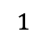
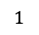
Breadth First Search
Pop
queue
A
B
D
Pops:
A
$$1$$
0
$$∞$$
$$∞$$
$$∞$$
Not been there yet
B
A
E
F
I
Been there, haven’t explored all the paths out
C
D
H
G
J
Been there, have explored all the paths out
$$∞$$
$$1$$
$$∞$$
$$∞$$
$$∞$$

Slide 27
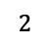
Breadth First Search
Pop
queue
B
D
C
Pops:
A
B
$$1$$
0
$$∞$$
$$∞$$
$$∞$$
Not been there yet
B
A
E
F
I
Been there, haven’t explored all the paths out
C
D
H
G
J
Been there, have explored all the paths out
$$2$$
$$1$$
$$∞$$
$$∞$$
$$∞$$

Slide 28
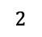
Breadth First Search
Pop
queue
D
C
E
H
Pops:
A
B
D
$$1$$
0
$$2$$
$$∞$$
$$∞$$
Not been there yet
B
A
E
F
I
Been there, haven’t explored all the paths out
C
D
H
G
J
Been there, have explored all the paths out
$$2$$
$$1$$
$$2$$
$$∞$$
$$∞$$

Slide 29
Breadth First Search
Pop
Pops:
A
B
D
queue
C
E
H
C
$$1$$
0
$$2$$
$$∞$$
$$∞$$
Not been there yet
B
A
E
F
I
Been there, haven’t explored all the paths out
C
D
H
G
J
Been there, have explored all the paths out
$$2$$
$$1$$
$$2$$
$$∞$$
$$∞$$

Slide 30
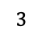
Breadth First Search
Pop
Pops:
A
B
D
queue
E
H
F
C
E
$$1$$
0
$$2$$
$$3$$
$$∞$$
Not been there yet
B
A
E
F
I
Been there, haven’t explored all the paths out
C
D
H
G
J
Been there, have explored all the paths out
$$2$$
$$1$$
$$2$$
$$∞$$
$$∞$$

Slide 31
Breadth First Search
Pop
Pops:
A
B
D
H
queue
H
F
G
C
E
$$1$$
0
$$2$$
$$3$$
$$∞$$
Not been there yet
B
A
E
F
I
Been there, haven’t explored all the paths out
C
D
H
G
J
Been there, have explored all the paths out
$$2$$
$$1$$
$$2$$
$$3$$
$$∞$$

Slide 32
Breadth First Search
Pop
Pops:
A
B
D
queue
F
G
C
E
H
F
$$1$$
0
$$2$$
$$3$$
$$∞$$
Not been there yet
B
A
E
F
I
Been there, haven’t explored all the paths out
C
D
H
G
J
Been there, have explored all the paths out
$$2$$
$$1$$
$$2$$
$$3$$
$$∞$$

Slide 33
Breadth First Search
Pop
Pops:
A
B
D
queue
G
C
E
H
F
G
$$1$$
0
$$2$$
$$3$$
$$∞$$
Not been there yet
B
A
E
F
I
Been there, haven’t explored all the paths out
C
D
H
G
J
Been there, have explored all the paths out
$$2$$
$$1$$
$$2$$
$$3$$
$$∞$$
One observation is that unreachable vertices are not found by BFS
In fact, this is true for any traversal algorithm

Slide 34
Breadth First Search Tree
A
$$1$$
0
$$2$$
$$3$$
$$∞$$
B
A
E
F
I
B
D
C
D
H
G
J
C
E
H
$$2$$
$$1$$
$$2$$
$$3$$
$$∞$$
BFS tree may not be unique – depends on the source node as well as the order of tie-break
F
G
However, for the same source, the distances of each node from the source remain the same

Slide 35
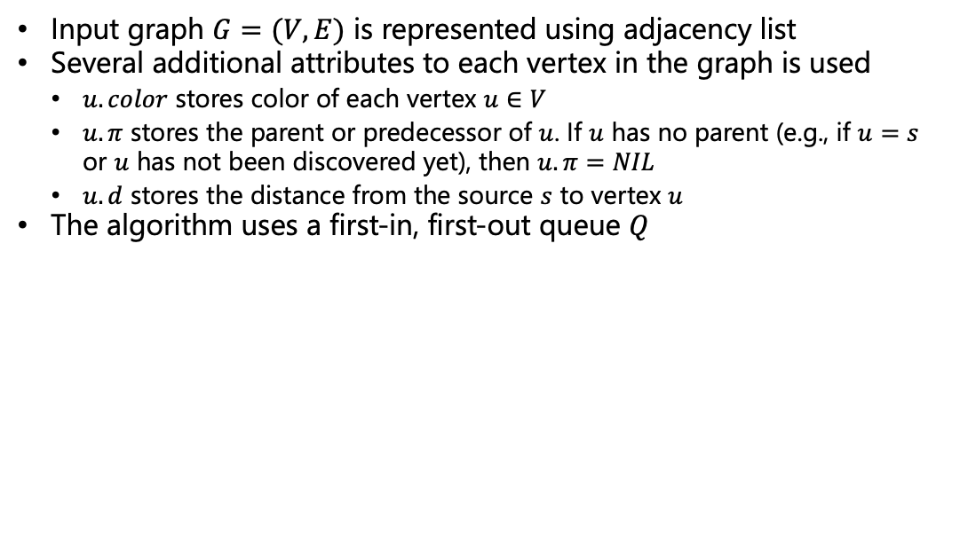
Breadth First Search - Pseudocode
Input graph $G=(V, E)$ is represented using adjacency list
Several additional attributes to each vertex in the graph is used
$u.color$ stores color of each vertex $u∈V$
$u.π$ stores the parent or predecessor of $u$. If $u$ has no parent (e.g., if $u=s$ or $u$ has not been discovered yet), then $u.π=NIL$
$u.d$ stores the distance from the source $s$ to vertex $u$
The algorithm uses a first-in, first-out queue $Q$

Slide 36
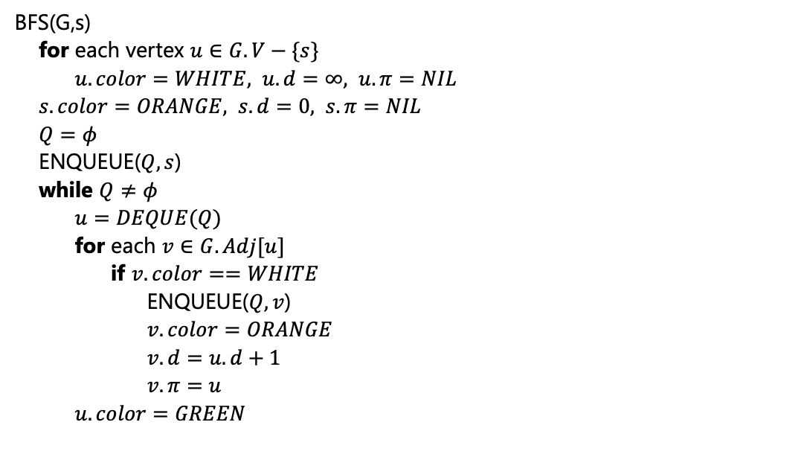
Breadth First Search - Pseudocode
BFS(G,s)
for each vertex $u∈G.V−\{s\}$
$u.color=WHITE, u.d=∞, u.π=NIL$
$s.color=ORANGE, s.d=0, s.π=NIL$
$Q=φ$
ENQUEUE($Q,s$)
while $Q≠φ$
$u=DEQUE(Q)$
for each $v∈G.Adj[u]$
if $v.color==WHITE$
ENQUEUE($Q,v$)
$v.color=ORANGE$
$v.d=u.d+1$
$v.π=u$
$u.color=GREEN$
B
A
E
F
C
D
H
G
A
B
D
B
A
C
C
D
A
E
H

Slide 37
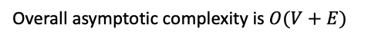
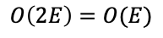
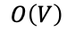
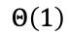
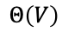
Breadth First Search - Analysis
BFS(G,s)
for each vertex $u∈G.V−\{s\}$
$u.color=WHITE, u.d=∞, u.π=NIL$
$s.color=ORANGE, s.d=0, s.π=NIL$
$Q=φ$
ENQUEUE($Q,s$)
while $Q≠φ$
$u=DEQUE(Q)$
for each $v∈G.Adj[u]$
if $v.color==WHITE$
ENQUEUE($Q,v$)
$v.color=ORANGE$
$v.d=u.d+1$
$v.π=u$
$u.color=GREEN$
$$Θ\left(V\right)$$
$$Θ\left(1\right)$$
$$O\left(V\right)$$
Overall, each vertex can be dequeued at most once
A
B
D
This line will be executed irrespective of whether the node is enqueued or not
B
A
C
C
Taking a look at the adjacency list, how many times, this gets executed?
D
A
E
H
$$O\left(2E\right)=O(E)$$
Overall asymptotic complexity is $O(V+E)$
Notes:
Why not theta(2E) → unreachable edges can be there
It is an aggregate complexity – not V.E, but V+E

Slide 38
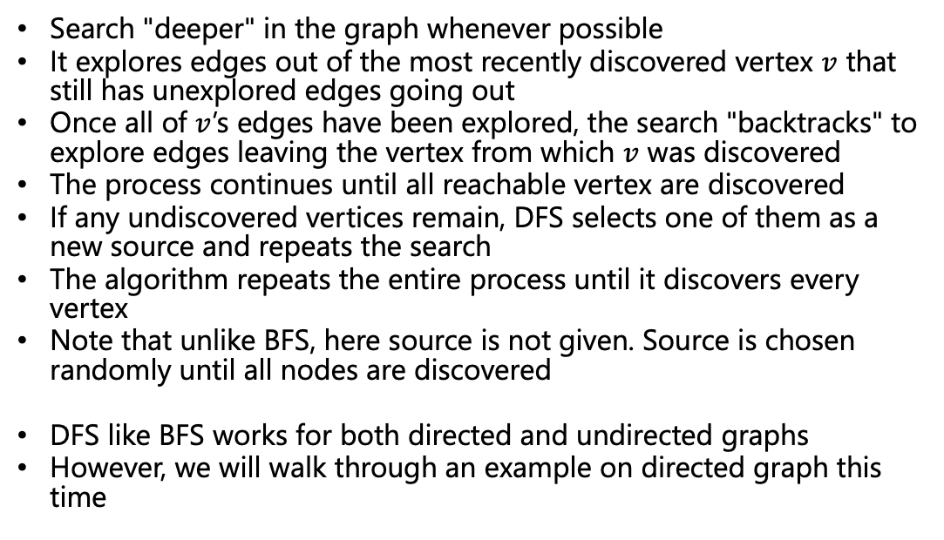
Depth First Search (DFS)
Search "deeper" in the graph whenever possible
It explores edges out of the most recently discovered vertex $v$ that still has unexplored edges going out
Once all of $v$’s edges have been explored, the search "backtracks" to explore edges leaving the vertex from which $v$ was discovered
The process continues until all reachable vertex are discovered
If any undiscovered vertices remain, DFS selects one of them as a new source and repeats the search
The algorithm repeats the entire process until it discovers every vertex
Note that unlike BFS, here source is not given. Source is chosen randomly until all nodes are discovered
DFS like BFS works for both directed and undirected graphs
However, we will walk through an example on directed graph this time

Slide 39
Depth First Search
Each vertex maintains two timestamps
start time: when vertex is discovered
finish time: When all nodes in adjacency list is visited
C
B
A
H
Not been there yet
Been there, haven’t explored all the paths out
D
E
F
G
Been there, have explored all the paths out
Notes:
These timestamps provide important information about the structure of the graph and are generally helpful in reasoning about the behavior of depth-first search.

Slide 40
Depth First Search
Each vertex maintains two timestamps
start time: when vertex is discovered
finish time: When all nodes in adjacency list is visited
1/
C
B
A
H
Not been there yet
Been there, haven’t explored all the paths out
D
E
F
G
Been there, have explored all the paths out

Slide 41
Depth First Search
Each vertex maintains two timestamps
start time: when vertex is discovered
finish time: When all nodes in adjacency list is visited
2/
1/
C
B
A
H
Not been there yet
Been there, haven’t explored all the paths out
D
E
F
G
Been there, have explored all the paths out

Slide 42
Depth First Search
Each vertex maintains two timestamps
start time: when vertex is discovered
finish time: When all nodes in adjacency list is visited
3/
2/
1/
C
B
A
H
Not been there yet
Been there, haven’t explored all the paths out
D
E
F
G
Been there, have explored all the paths out

Slide 43
Depth First Search
Each vertex maintains two timestamps
start time: when vertex is discovered
finish time: When all nodes in adjacency list is visited
We will not go to B as that will make a cycle
Rule is – if an edge takes you back to a “discovered but not finished” node then we will say that’s a backwards edge (or simply a back edge)
3/
2/
1/
C
B
A
H
Not been there yet
Been there, haven’t explored all the paths out
D
E
F
G
Been there, have explored all the paths out
4/

Slide 44
Depth First Search
Each vertex maintains two timestamps
start time: when vertex is discovered
finish time: When all nodes in adjacency list is visited
3/
2/
1/
C
B
A
H
Not been there yet
Been there, haven’t explored all the paths out
D
E
F
G
Been there, have explored all the paths out
4/5

Slide 45
Depth First Search
Each vertex maintains two timestamps
start time: when vertex is discovered
finish time: When all nodes in adjacency list is visited
3/6
2/
1/
C
B
A
H
Not been there yet
Been there, haven’t explored all the paths out
D
E
F
G
Been there, have explored all the paths out
4/5

Slide 46
Depth First Search
Each vertex maintains two timestamps
start time: when vertex is discovered
finish time: When all nodes in adjacency list is visited
However, edge (E, D) is not a back edge
It does not get us back to an “unfinished” node, rather takes us to an already finished node – meaning no cycle
3/6
2/
1/
C
B
A
H
Not been there yet
Been there, haven’t explored all the paths out
D
E
F
G
Been there, have explored all the paths out
4/5
7/
Notes:
Not back edge – Since D is already finished, it is not necessarily true that there is an additional path from D to E. But, anyway D is finished/discovered, so we will not visit D

Slide 47
Depth First Search
Each vertex maintains two timestamps
start time: when vertex is discovered
finish time: When all nodes in adjacency list is visited
3/6
2/
1/
C
B
A
H
Not been there yet
Been there, haven’t explored all the paths out
D
E
F
G
Been there, have explored all the paths out
4/5
7/8

Slide 48
Depth First Search
Each vertex maintains two timestamps
start time: when vertex is discovered
finish time: When all nodes in adjacency list is visited
3/6
2/9
1/
C
B
A
H
Not been there yet
Been there, haven’t explored all the paths out
D
E
F
G
Been there, have explored all the paths out
4/5
7/8

Slide 49
Depth First Search
Each vertex maintains two timestamps
start time: when vertex is discovered
finish time: When all nodes in adjacency list is visited
The fact that we always go back to the last node is consistent with the behavior of a stack
3/6
2/9
1/10
C
B
A
H
Not been there yet
Been there, haven’t explored all the paths out
D
E
F
G
Been there, have explored all the paths out
4/5
7/8

Slide 50
Depth First Search
Each vertex maintains two timestamps
start time: when vertex is discovered
finish time: When all nodes in adjacency list is visited
3/6
2/9
1/10
11/
C
B
A
H
Not been there yet
Been there, haven’t explored all the paths out
D
E
F
G
Been there, have explored all the paths out
4/5
7/8

Slide 51
Depth First Search
Each vertex maintains two timestamps
start time: when vertex is discovered
finish time: When all nodes in adjacency list is visited
3/6
2/9
1/10
11/
C
B
A
H
Not been there yet
Been there, haven’t explored all the paths out
D
E
F
G
Been there, have explored all the paths out
4/5
7/8
12/

Slide 52
Depth First Search
Each vertex maintains two timestamps
start time: when vertex is discovered
finish time: When all nodes in adjacency list is visited
3/6
2/9
1/10
11/
C
B
A
H
Not been there yet
Been there, haven’t explored all the paths out
D
E
F
G
Been there, have explored all the paths out
4/5
7/8
12/13
14/

Slide 53
Depth First Search
Each vertex maintains two timestamps
start time: when vertex is discovered
finish time: When all nodes in adjacency list is visited
3/6
2/9
1/10
11/
C
B
A
H
Not been there yet
Been there, haven’t explored all the paths out
D
E
F
G
Been there, have explored all the paths out
4/5
7/8
12/13
14/15

Slide 54
Depth First Search
Each vertex maintains two timestamps
start time: when vertex is discovered
finish time: When all nodes in adjacency list is visited
Of course, DFS is not unique (as source is not given)
Can you identify a node as the very first source that would have explored all nodes without going for another source node?
3/6
2/9
1/10
11/16
C
B
A
H
Not been there yet
Been there, haven’t explored all the paths out
D
E
F
G
Been there, have explored all the paths out
4/5
7/8
12/13
14/15
Notes:
H or G

Slide 55
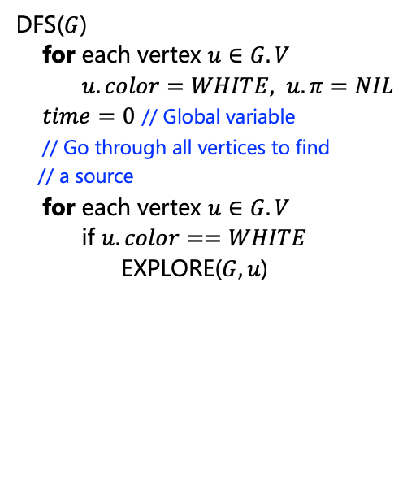
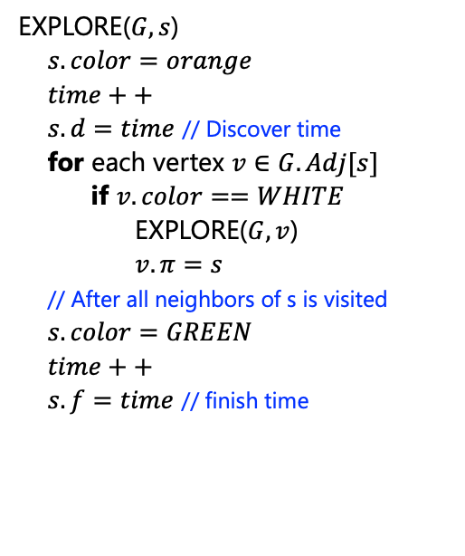
Depth First Search - Pseudocode
DFS($G$)
for each vertex $u∈G.V$
$u.color=WHITE, u.π=NIL$
$time=0$ // Global variable
// Go through all vertices to find
// a source
for each vertex $u∈G.V$
if $u.color==WHITE$
EXPLORE($G,u$)
EXPLORE($G,s$)
$s.color=orange$
$time++$
$s.d=time$ // Discover time
for each vertex $v∈G.Adj[s]$
if $v.color==WHITE$
EXPLORE($G,v$)
$v.π=s$
// After all neighbors of s is visited
$s.color=GREEN$
$time++$
$s.f=time$ // finish time
C
B
A
H
D
E
F
G

Slide 56
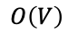
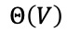
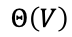
Depth First Search - Analysis
DFS($G$)
for each vertex $u∈G.V$
$u.color=WHITE, u.π=NIL$
$time=0$ // Global variable
// Go through all vertices to find
// a source
for each vertex $u∈G.V$
if $u.color==WHITE$
EXPLORE($G,u$)
$$Θ\left(V\right)$$
Only this line?
$$Θ\left(V\right)$$
Only this line?
$$O\left(V\right)$$
Gets called equal to number of trees in the forest

Slide 57
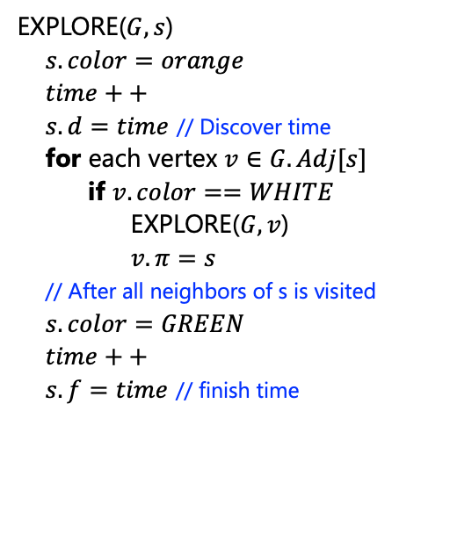
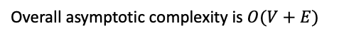


Depth First Search - Pseudocode
EXPLORE($G,s$)
$s.color=orange$
$time++$
$s.d=time$ // Discover time
for each vertex $v∈G.Adj[s]$
if $v.color==WHITE$
EXPLORE($G,v$)
$v.π=s$
// After all neighbors of s is visited
$s.color=GREEN$
$time++$
$s.f=time$ // finish time
$$Θ\left(V\right)$$
Analysis exactly like BFS
In aggregate, $θ(E)$
Overall asymptotic complexity is $O(V+E)$

Slide 58
Topological Sort
Lets consider a dependency graph showing the dependency of different courses for a (part of a) CS curriculum
We need to come up with an ordering of the courses that satisfies the dependencies
PDS
DM
Algo1
PDS
Algo1
DM
Algo2
OS
SE
DB
Sec
PDS
Algo1
Algo2
.
.
.
Algo2
SE
OS
DB
✅
❌
Sec
Notes:
H or G

Slide 59

Topological Sort
A topological sort of a Directed Acyclic Graph (DAG) $G=(V,E)$ is a linear ordering of all its vertices such that if $G$ contains an edge $(u,v)$ then $u$ appears before $v$ in the ordering
If the graph contains a cycle, then no linear ordering is possible
PDS
DM
Algo1
Algo2
SE
OS
DB
Sec
Notes:
H or G

Slide 60
Topological Sort
Let us try to think of an algorithm
Remember that the graph is represented as an adjacency list which is the input to the algorithm
Intuitively, the ordering should start either with ‘PDS’ or ’DM’. How to find them from the adjacency list?
PDS
DM
Algo1
PDS
Algo1
Algo2
Algo1
Algo2
Algo2
SE
OS
DB
SE
OS
DB
DM
Algo2
SE
OS
Sec
Sec
DB
Sec
Sec
Notes:
H or G

Slide 61
Topological Sort
Assign a counter to each node of the graph that counts, from the adjacency list, how many incoming edges are connected to each node
Nodes with 0 incoming edges are potential start nodes
PDS
DM
Algo1
PDS
Algo1
Algo2
Algo1
Algo2
Algo2
SE
OS
DB
SE
OS
DB
DM
Algo2
SE
OS
Sec
Sec
DB
Sec
Sec
Notes:
H or G

Slide 62
Topological Sort
DepCnt=0
So, we start with say PDS
PDS
PDS
DepCnt=0
DepCnt=1
DM
Algo1
DepCnt=2
PDS
Algo1
Algo2
Algo1
Algo2
DepCnt=1
DepCnt=1
DepCnt=1
Algo2
SE
OS
DB
SE
OS
DB
DM
Algo2
SE
DepCnt=2
OS
Sec
Sec
DB
Sec
Sec
Notes:
H or G

Slide 63
Topological Sort
DepCnt=0
PDS
PDS
DepCnt=0
DepCnt=1 0
DM
Algo1
DepCnt=2
PDS
Algo1
Algo2
Algo1
Algo2
DepCnt=1
DepCnt=1
DepCnt=1
Algo2
SE
OS
DB
SE
OS
DB
DM
Algo2
SE
DepCnt=2
OS
Sec
Sec
DB
Sec
Sec
Notes:
H or G

Slide 64
Topological Sort
DepCnt=0
PDS
PDS, Algo1
DepCnt=0
DepCnt=1 0
DM
Algo1
DepCnt=2 1
PDS
Algo1
Algo2
Algo1
Algo2
DepCnt=1
DepCnt=1
DepCnt=1
Algo2
SE
OS
DB
SE
OS
DB
DM
Algo2
SE
DepCnt=2
OS
Sec
Sec
DB
Sec
Sec
Notes:
H or G

Slide 65
Topological Sort
DepCnt=0
PDS
PDS, Algo1, DM
DepCnt=0
DepCnt=1 0
DM
Algo1
DepCnt=2 1 0
PDS
Algo1
Algo2
Algo1
Algo2
DepCnt=1
DepCnt=1
DepCnt=1
Algo2
SE
OS
DB
SE
OS
DB
DM
Algo2
SE
DepCnt=2
OS
Sec
Sec
DB
Sec
Sec
Notes:
H or G

Slide 66
Topological Sort
DepCnt=0
PDS
PDS, Algo1, DM, Algo2
DepCnt=0
DepCnt=1 0
DM
Algo1
DepCnt=2 1 0
PDS
Algo1
Algo2
Algo1
Algo2
DepCnt=1 0
DepCnt=1 0
DepCnt=1 0
Algo2
SE
OS
DB
SE
OS
DB
DM
Algo2
SE
DepCnt=2
OS
Sec
Sec
DB
Sec
Sec
Notes:
H or G

Slide 67
Topological Sort
DepCnt=0
PDS
PDS, Algo1, DM, Algo2, SE
DepCnt=0
DepCnt=1 0
DM
Algo1
DepCnt=2 1 0
PDS
Algo1
Algo2
Algo1
Algo2
DepCnt=1 0
DepCnt=1 0
DepCnt=1 0
Algo2
SE
OS
DB
SE
OS
DB
DM
Algo2
SE
DepCnt=2
OS
Sec
Sec
DB
Sec
Sec
Notes:
H or G

Slide 68
Topological Sort
DepCnt=0
PDS
PDS, Algo1, DM, Algo2, SE, OS
DepCnt=0
DepCnt=1 0
DM
Algo1
DepCnt=2 1 0
PDS
Algo1
Algo2
Algo1
Algo2
DepCnt=1 0
DepCnt=1 0
DepCnt=1 0
Algo2
SE
OS
DB
SE
OS
DB
DM
Algo2
SE
DepCnt=2 1
OS
Sec
Sec
DB
Sec
Sec
Notes:
H or G

Slide 69
Topological Sort
DepCnt=0
PDS
PDS, Algo1, DM, Algo2, SE, OS, DB
DepCnt=0
DepCnt=1 0
DM
Algo1
DepCnt=2 1 0
PDS
Algo1
Algo2
Algo1
Algo2
DepCnt=1 0
DepCnt=1 0
DepCnt=1 0
Algo2
SE
OS
DB
SE
OS
DB
DM
Algo2
SE
DepCnt=2 1 0
OS
Sec
Sec
DB
Sec
Sec
Notes:
H or G

Slide 70
Topological Sort
DepCnt=0
PDS
PDS, Algo1, DM, Algo2, SE, OS, DB, Sec
DepCnt=0
DepCnt=1 0
DM
Algo1
DepCnt=2 1 0
PDS
Algo1
Algo2
Algo1
Algo2
DepCnt=1 0
DepCnt=1 0
DepCnt=1 0
Algo2
SE
OS
DB
SE
OS
DB
DM
Algo2
SE
DepCnt=2 1 0
OS
Sec
Sec
DB
Sec
Sec
Notes:
H or G

Slide 71

Topological Sort - Pseudocode
DepCnt=0
TopoSort($G$)
for each vertex $u∈G.V$
$u.DepCnt=0$
for each vertex $u∈G.V$
for each neighbor $v∈G.Adj[u]$
$v.DepCnt++$
// Initialize two lists – one for ‘ready’ nodes and one for ‘solution’ nodes
for each vertex $u∈G.V$
if $u.DepCnt==0$
$R.Append(u)$
$S=φ$
while $R≠φ$
$u=R.Pop()$
$S.Append(u)$
for each neighbor $v∈G.Adj[u]$
$v.DepCnt−−$
if $v.DepCnt==0$
$R.Append(v)$
PDS
DepCnt=0
DepCnt=1 0
DM
Algo1
DepCnt=2 1 0
Algo2
DepCnt=1 0
DepCnt=1 0
DepCnt=1 0
SE
OS
DB
DepCnt=2 1 0
Sec
Notes:
H or G

Slide 72






Topological Sort - Analysis
PDS
TopoSort($G$)
for each vertex $u∈G.V$
$u.DepCnt=0$
for each vertex $u∈G.V$
for each neighbor $v∈G.Adj[u]$
$v.DepCnt++$
// Initialize two lists – one for ‘ready’ nodes and one for ‘solution’ nodes
for each vertex $u∈G.V$
if $u.DepCnt==0$
$R.Append(u)$
$S=φ$
while $R≠φ$
$u=R.Pop()$
$S.Append(u)$
for each neighbor $v∈G.Adj[u]$
$v.DepCnt−−$
if $v.DepCnt==0$
$R.Append(v)$
$$Θ\left(V\right)$$
DM
Algo1
$$θ\left(E\right)$$
Algo2
SE
OS
DB
Sec
$$Θ\left(V\right)$$
PDS
Algo1
Algo1
Algo2
Algo2
SE
OS
DB
DM
Algo2
$$θ\left(E\right)$$
SE
OS
Sec
DB
Sec
Overall asymptotic complexity is $θ(V+E)$
Sec
Notes:
H or G

Slide 73
Topological Sort - DFS
1/
DFS can be an easier way to perform topological sorting
PDS
DM
Algo1
Algo2
Not been there yet
Been there, haven’t explored all the paths out
SE
OS
DB
Been there, have explored all the paths out
Sec
Notes:
H or G

Slide 74
Topological Sort - DFS
1/
DFS can be an easier way to perform topological sorting
PDS
2/
DM
Algo1
Algo2
Not been there yet
Been there, haven’t explored all the paths out
SE
OS
DB
Been there, have explored all the paths out
Sec
Notes:
H or G

Slide 75
Topological Sort - DFS
1/
DFS can be an easier way to perform topological sorting
PDS
2/
DM
Algo1
3/
Algo2
Not been there yet
Been there, haven’t explored all the paths out
SE
OS
DB
Been there, have explored all the paths out
Sec
Notes:
H or G

Slide 76
Topological Sort - DFS
1/
DFS can be an easier way to perform topological sorting
PDS
2/
DM
Algo1
3/
Algo2
Not been there yet
4/
Been there, haven’t explored all the paths out
SE
OS
DB
Been there, have explored all the paths out
Sec
Notes:
H or G

Slide 77
Topological Sort - DFS
1/
DFS can be an easier way to perform topological sorting
What can we say or where can we put a finished node in the list?
PDS
2/
DM
Algo1
SE
3/
Algo2
Not been there yet
4/5
Been there, haven’t explored all the paths out
SE
OS
DB
Been there, have explored all the paths out
Sec
Notes:
H or G

Slide 78
Topological Sort - DFS
1/
DFS can be an easier way to perform topological sorting
What can we say or where can we put a finished node in the list?
PDS
2/
DM
Algo1
SE
3/
Algo2
Not been there yet
4/5
6/
Been there, haven’t explored all the paths out
SE
OS
DB
Been there, have explored all the paths out
Sec
Notes:
H or G

Slide 79
Topological Sort - DFS
1/
DFS can be an easier way to perform topological sorting
What can we say or where can we put a finished node in the list?
PDS
2/
DM
Algo1
SE
3/
Algo2
Not been there yet
4/5
6/
Been there, haven’t explored all the paths out
SE
OS
DB
7/
Been there, have explored all the paths out
Sec
Notes:
H or G

Slide 80
Topological Sort - DFS
1/
DFS can be an easier way to perform topological sorting
What can we say or where can we put a finished node in the list?
PDS
2/
DM
Algo1
Sec, SE
3/
Algo2
Not been there yet
4/5
6/
Been there, haven’t explored all the paths out
SE
OS
DB
7/8
Been there, have explored all the paths out
Sec
Notes:
H or G

Slide 81
Topological Sort - DFS
1/
DFS can be an easier way to perform topological sorting
What can we say or where can we put a finished node in the list?
PDS
2/
DM
Algo1
OS, Sec, SE
3/
Algo2
Not been there yet
4/5
6/9
Been there, haven’t explored all the paths out
SE
OS
DB
7/8
Been there, have explored all the paths out
Sec
Notes:
H or G

Slide 82
Topological Sort - DFS
1/
DFS can be an easier way to perform topological sorting
What can we say or where can we put a finished node in the list?
PDS
2/
DM
Algo1
OS, Sec, SE
3/
Algo2
Not been there yet
4/5
6/9
10/
Been there, haven’t explored all the paths out
SE
OS
DB
7/8
Been there, have explored all the paths out
Sec
Notes:
H or G

Slide 83
Topological Sort - DFS
1/
DFS can be an easier way to perform topological sorting
What can we say or where can we put a finished node in the list?
PDS
2/
DM
Algo1
DB, OS, Sec, SE
3/
Algo2
Not been there yet
4/5
6/9
10/11
Been there, haven’t explored all the paths out
SE
OS
DB
7/8
Been there, have explored all the paths out
Sec
Notes:
H or G

Slide 84
Topological Sort - DFS
1/
DFS can be an easier way to perform topological sorting
What can we say or where can we put a finished node in the list?
PDS
2/
DM
Algo1
Algo2, DB, OS, Sec, SE
3/12
Algo2
Not been there yet
4/5
6/9
10/11
Been there, haven’t explored all the paths out
SE
OS
DB
7/8
Been there, have explored all the paths out
Sec
Notes:
H or G

Slide 85
Topological Sort - DFS
1/
DFS can be an easier way to perform topological sorting
What can we say or where can we put a finished node in the list?
PDS
2/13
DM
Algo1
Algo1, Algo2, DB, OS, Sec, SE
3/12
Algo2
Not been there yet
4/5
6/9
10/11
Been there, haven’t explored all the paths out
SE
OS
DB
7/8
Been there, have explored all the paths out
Sec
Notes:
H or G

Slide 86
Topological Sort - DFS
1/14
DFS can be an easier way to perform topological sorting
What can we say or where can we put a finished node in the list?
PDS
2/13
DM
Algo1
PDS, Algo1, Algo2, DB, OS, Sec, SE
3/12
Algo2
Not been there yet
4/5
6/9
10/11
Been there, haven’t explored all the paths out
SE
OS
DB
7/8
Been there, have explored all the paths out
Sec
Notes:
H or G

Slide 87
Topological Sort - DFS
1/14
DFS can be an easier way to perform topological sorting
What can we say or where can we put a finished node in the list?
PDS
15/
2/13
DM
Algo1
PDS, Algo1, Algo2, DB, OS, Sec, SE
3/12
Algo2
Not been there yet
4/5
6/9
10/11
Been there, haven’t explored all the paths out
SE
OS
DB
7/8
Been there, have explored all the paths out
Sec
Notes:
H or G

Slide 88
Topological Sort - DFS
1/14
DFS can be an easier way to perform topological sorting
What can we say or where can we put a finished node in the list?
PDS
15/16
2/13
DM
Algo1
DM, PDS, Algo1, Algo2, DB, OS, Sec, SE
3/12
Algo2
Not been there yet
4/5
6/9
10/11
Been there, haven’t explored all the paths out
SE
OS
DB
7/8
Been there, have explored all the paths out
Sec
Notes:
H or G

Slide 89

Topological Sort - DFS
1/14
DFS can be an easier way to perform topological sorting
What can we say or where can we put a finished node in the list?
PDS
15/16
2/13
DM
Algo1
DM, PDS, Algo1, Algo2, DB, OS, Sec, SE
3/12
The algorithm simply put is,
Do DFS and whenever a vertex $u$ is finished do $S.AddToHead(u)$
The complexity is same as DFS i.e., $θ(V+E)$
Algo2
4/5
6/9
10/11
SE
OS
DB
7/8
Sec
Notes:
H or G

Slide 90



Single Source Shortest Paths
B
1
C
Given a weighted directed graph and a source the problem is to find the shortest paths to every vertex of the graph from the source
If $A$ is the source, then shortest distances to all the nodes i.e., shortest distances $\left(A, B\right), \left(A, C\right), (A, D)$ and $(A, E)$ are required
Note that it’s a weighted graph
10
9
A
3
2
4
6
7
5
E
D
2
Shortest-paths problem: We are given a weighted, directed graph $G=(V,E)$, with weight function $w:E→ ℝ$ mapping edges to real-valued weights. The weight $w(p)$ of path $p=<v_{0},v_{1},…,v_{k}>$ is the sum of the weights of its constituent edges.
We define the shortest-path weight $δ(u,v)$ from $u$ to $v$ by
$δ\left(u,v\right)= \left\{\begin{aligned}\min\left\{w\left(p\right):u↝v\right\} if there is a path from u to v \\ ∞. otherwise\end{aligned}\right.$
A shortest path from vertex $u$ to vertex $v$ is then defined as any path $p$ with weight $w\left(p\right)=δ(u,v)$
$$p$$
Notes:
H or G

Slide 91


Shortest Path Variants
B
1
C
Single-destination shortest-paths problem: Finding a shortest path to a given destination vertex $t$ from each vertex $v$
By reversing the direction of each edge in the graph the problem can be reduced to a single-source problem
10
9
A
3
2
4
6
7
5
E
D
2
Single-pair shortest-path problem: Find a shortest path from $u$ to $v$ for given vertices $u$ and $v$
If we solve the single-source problem with source vertex $u$, we solve this problem also
All-pairs shortest-paths problem: Find a shortest path from $u$ to $v$ for every pair of vertices $u$ and $v$
Can be solved by running a single source algorithm from each vertex. However, we usually can solve it faster
Will see such algorithms later (if time permits)
Notes:
H or G

Slide 92

Single Source Shortest Paths
B
1
C
Of course, if the graph is unweighted, we can use BFS
As the problem in hand is more general, the solution is expected to be more complex than BFS
Let us consider $A$ as the source node and try to observe a few things
10
9
A
3
2
4
6
7
5
E
D
2
Notes:
H or G

Slide 93

Single Source Shortest Paths
B
1
C
Of course, if the graph is unweighted, we can use BFS
As the problem in hand is more general, the solution is expected to be more complex than BFS
Let us consider $A$ as the source node and try to observe a few things
10
9
A
3
2
4
6
7
5
E
D
2
Considering $A$ as the source
Is 5 the shortest distance between $A$ and $E$?
Is 10 the shortest distance between $A$ and $B$?
Answer is Yes and ‘can’t tell’ respectively
For $AE$, any other path (via any other neighbor of $A$) will incur more cost than 5 (as 5 is the least weight among the neighboring edges of $A$)
For $AB$, we can not say this for sure as there may be paths via other neighbors of $A$ (say path via $AE$) whose sum of weights may be less
Notes:
H or G

Slide 94

Single Source Shortest Paths
B
1
C
A
3
10
9
4
A
3
2
S
B
4
6
7
5
5
E
D
6
C
2
D
Generally speaking for a scenario shown in top-right, only for edge $SA$ we know for sure that this is the shortest path from $S$ to $A$
For others, we are not sure
What is the assumption here?
Edge weights are always positive
Dijkstra’s algorithm is guaranteed to work for graphs with positive edge weights
For graphs with negative edge weights, we will study another algorithm
Notes:
H or G

Slide 95

Single Source Shortest Paths
B
1
C
A
3
10
9
4
A
3
2
S
B
4
6
7
5
5
E
D
6
C
2
D
For the node $A$, the path is the shortest path to $A$
For all other nodes we are not sure
This slick fact is exploited in Dijkstra’s algorithm
Dijkstra’s algorithm is thus a greedy algorithm
Lets see what Dijkstra’s philosophy about ‘algorithms’ is
Notes:
H or G

Slide 96

Single Source Shortest Paths
Image source: www.azquotes.com/quote/754978
Notes:
H or G

Slide 97




Single Source Shortest Paths
$$∞$$
$$∞$$
 | d | $$π$$
A | 0 | Null
B | $∞$ | Null
C | $∞$ | Null
D | $∞$ | Null
E | $∞$ | Null
B
1
C
10
9
A
3
2
4
6
7
5
E
D
2
5
$$∞$$
Notes:
H or G

Slide 98

Single Source Shortest Paths
10
$$∞$$
 | d | $$π$$
A | 0 | Null
B | $∞$ 10 | Null A
C | $∞$ | Null
D | $∞$ | Null
E | $∞$ 5 | Null A
B
1
C
10
9
A
3
2
4
6
7
5
E
D
2
5
$$∞$$
Notes:
H or G

Slide 99

Single Source Shortest Paths
10
$$∞$$
 | d | $$π$$
A | 0 | Null
B | $∞$ 10 | Null A
C | $∞$ | Null
D | $∞$ | Null
E | $∞$ 5 | Null A
B
1
C
10
9
A
3
2
4
6
7
5
E
D
2
5
$$∞$$
Now, I know, $E$ can not get any better. So, I shall first update the neighbors of $E$ and I shall not consider $E$ again
For $A$ also, same thing applies
Notes:
H or G

Slide 100

Single Source Shortest Paths
8
14
 | d | $$π$$
A | 0 | Null
B | $∞$ 10 8 | Null A E
C | $∞$ 14 | Null E
D | $∞$ 7 | Null E
E | $∞$ 5 | Null A
B
1
C
10
9
A
3
2
4
6
7
5
E
D
2
5
7
Notes:
H or G

Slide 101


Single Source Shortest Paths
8
14
 | d | $$π$$
✅A | 0 | Null
B | $∞$ 10 8 | Null A E
C | $∞$ 14 | Null E
D | $∞$ 7 | Null E
✅E | $∞$ 5 | Null A
B
1
C
10
9
A
3
2
4
6
7
5
E
D
2
5
7
Among the three remaining $D$ can not get any better. So, I shall update the neighbors of $D$ and I shall not consider $D$ again
Notes:
H or G

Slide 102

Single Source Shortest Paths
8
13
 | d | $$π$$
✅A | 0 | Null
B | $∞$ 10 8 | Null A E
C | $∞$ 14 13 | Null E D
D | $∞$ 7 | Null E
✅E | $∞$ 5 | Null A
B
1
C
10
9
A
3
2
4
6
7
5
E
D
2
5
7
Notes:
H or G

Slide 103


Single Source Shortest Paths
8
13
 | d | $$π$$
✅A | 0 | Null
B | $∞$ 10 8 | Null A E
C | $∞$ 14 13 | Null E D
✅D | $∞$ 7 | Null E
✅E | $∞$ 5 | Null A
B
1
C
10
9
A
3
2
4
6
7
5
E
D
2
5
7
Among the two remaining $B$ can not get any better. So, I shall update the neighbors of $B$ and I shall not consider $B$ again
Notes:
H or G

Slide 104

Single Source Shortest Paths
8
9
 | d | $$π$$
✅A | 0 | Null
B | $∞$ 10 8 | Null A E
C | $∞$ 14 13 9 | Null E D B
✅D | $∞$ 7 | Null E
✅E | $∞$ 5 | Null A
B
1
C
10
9
A
3
2
4
6
7
5
E
D
2
5
7
Notes:
H or G

Slide 105


Single Source Shortest Paths
8
9
 | d | $$π$$
✅A | 0 | Null
✅B | $∞$ 10 8 | Null A E
C | $∞$ 14 13 9 | Null E D B
✅D | $∞$ 7 | Null E
✅E | $∞$ 5 | Null A
B
1
C
10
9
A
3
2
4
6
7
5
E
D
2
5
7
$C$ is the only remaining vertex and it is not going to update anything
$C$ has the shortest distance of 9
Notes:
H or G

Slide 106


Single Source Shortest Paths
8
9
 | d | $$π$$
✅A | 0 | Null
✅B | $∞$ 10 8 | Null A E
✅C | $∞$ 14 13 9 | Null E D B
✅D | $∞$ 7 | Null E
✅E | $∞$ 5 | Null A
B
1
C
10
9
A
3
2
4
6
7
5
E
D
2
5
7
$C$ is the only remaining vertex and it is not going to update anything
$C$ has the shortest distance of 9
To get the path to $C$, we trace the parents starting from $C$
It will be $C←B←E←A$
Notes:
H or G

Slide 107


Dijkstra’s Algorithm - Pseudocode
8
9
Dijkstra($G,s$)
for each vertex $u∈G.V$
$u.d =∞, u.π=Null$
$s.d=0$
// Initialize a data structure for the vertices
$Q=φ$ // Priority queue
for each vertex $u∈G.V$
$Q.Insert(u)$
while $Q≠φ$
$u=Q.getMin()$
for each neighbor $v∈G.Adj[u]$
if $u.d+w\left(u,v\right)<v.d$
$v.d=u.d+w(u,v)$
$v.π=u$
B
1
C
10
9
A
3
2
4
6
7
5
E
D
5
2
7
 | d | $$π$$
✅A | 0 | Null
✅B | $∞$ 10 8 | Null A E
✅C | $∞$ 14 13 9 | Null E D B
✅D | $∞$ 7 | Null E
✅E | $∞$ 5 | Null A
Notes:
H or G

Slide 108





Dijkstra’s Algorithm - Analysis
8
9
Dijkstra($G,s$)
for each vertex $u∈G.V$
$u.d =∞, u.π=Null$
$s.d=0$
// Initialize a data structure for the vertices
$Q=φ$ // Priority queue
for each vertex $u∈G.V$
$Q.Insert(u)$
while $Q≠φ$
$u=Q.getMin()$
for each neighbor $v∈G.Adj[u]$
if $u.d+w\left(u,v\right)<v.d$
$v.d=u.d+w(u,v)$
$v.π=u$
B
1
C
10
$$Θ\left(V\right)$$
9
A
3
2
4
6
7
5
E
D
$V$ Inserts
5
2
7
$V$ Extracts
 | d | $$π$$
✅A | 0 | Null
✅B | $∞$ 10 8 | Null A E
✅C | $∞$ 14 13 9 | Null E D B
✅D | $∞$ 7 | Null E
✅E | $∞$ 5 | Null A
$E$ condition
checks
As we are using priority queue, there are costs associated with inserts, extracts and change priorities
Notes:
H or G

Slide 109










Remembering Priority Queue
8
9
Dijkstra($G,s$)
for each vertex $u∈G.V$
$u.d =∞, u.π=Null$
$s.d=0$
// Initialize a data structure for the vertices
$Q=φ$ // Priority queue
for each vertex $u∈G.V$
$Q.Insert(u)$
while $Q≠φ$
$u=Q.getMin()$
for each neighbor $v∈G.Adj[u]$
if $u.d+w\left(u,v\right)<v.d$
$v.d=u.d+w(u,v)$
$v.π=u$
B
1
C
$$Θ\left(V\right)$$
10
9
A
3
2
4
6
7
5
E
D
$V$ Inserts
5
2
7
$V$ Extracts
 | Heap | Unsorted Array
Insert
ExtractMin
DecreaseKey
$E$ checks
$$O(\log{n})$$
$$O(1)$$
$$O(\log{n})$$
$$O(n)$$
$$O(\log{n})$$
$$O(1)$$
Notes:
H or G

Slide 110











Dijkstra’s Algorithm - Analysis
Dijkstra($G,s$)
for each vertex $u∈G.V$
$u.d =∞, u.π=Null$
$s.d=0$
// Initialize a data structure for the vertices
$Q=φ$ // Priority queue
for each vertex $u∈G.V$
$Q.Insert(u)$
while $Q≠φ$
$u=Q.getMin()$
for each neighbor $v∈G.Adj[u]$
if $u.d+w\left(u,v\right)<v.d$
$v.d=u.d+w(u,v)$
$v.π=u$
 | Heap | Unsorted Array
Insert
ExtractMin
DecreaseKey
$$Θ\left(V\right)$$
$$O(\log{n})$$
$$O(1)$$
$$O(\log{n})$$
$$O(n)$$
$V$ Inserts
$$O(\log{n})$$
$$O(1)$$
With a Heap
$$T\left(V,E\right)=$$
$V$ Extracts
$$O\left(V\log{V}\right)+$$
$$O\left(V\log{V}\right)+$$
$E$ checks
$$O\left(E\log{V}\right)$$
$$=O\left(V\log{V}\right)+O(E\log{V})$$
For a connected graph, number of edges is of the order of $V$ i.e., $E=Ω\left(V\right).$
$T\left(V,E\right)=O\left(E\log{V}\right)$
Notes:
Last line – As E is greater than or equal to V

Slide 111


















Dijkstra’s Algorithm - Analysis
Dijkstra($G,s$)
for each vertex $u∈G.V$
$u.d =∞, u.π=Null$
$s.d=0$
// Initialize a data structure for the vertices
$Q=φ$ // Priority queue
for each vertex $u∈G.V$
$Q.Insert(u)$
while $Q≠φ$
$u=Q.getMin()$
for each neighbor $v∈G.Adj[u]$
if $u.d+w\left(u,v\right)<v.d$
$v.d=u.d+w(u,v)$
$v.π=u$
With a Heap
$$T\left(V,E\right)=$$
$$Θ\left(V\right)$$
$$O\left(V\log{V}\right)+$$
$$O\left(V\log{V}\right)+$$
$$O\left(E\log{V}\right)$$
$$=O\left(V\log{V}\right)+O(E\log{V})$$
$$=O\left(E\log{V}\right)$$
, If connected graph
$V$ Inserts
With an unsorted array
$$T\left(V,E\right)=$$
$V$ Extracts
$$O\left(V\right)+$$
$$O\left(V^{2}\right)+$$
$$O\left(E\right)$$
$$=O\left(V^{2}\right)$$
Can we write this?
$E$ checks
 | Heap | Unsorted Array
Insert
ExtractMin
DecreaseKey
$$O(\log{n})$$
$$O(1)$$
$$O(\log{n})$$
$$O(n)$$
$$O(\log{n})$$
$$O(1)$$

Slide 112










Dijkstra’s Algorithm - Analysis
With a Heap
$$T\left(V,E\right)=$$
 | Heap | Unsorted Array
Insert
ExtractMin
DecreaseKey
$$O\left(V\log{V}\right)+$$
$$O\left(V\log{V}\right)+$$
$$O(\log{n})$$
$$O(1)$$
$$O\left(E\log{V}\right)$$
$$O(\log{n})$$
$$O(n)$$
$$=O\left(V\log{V}\right)+O(E\log{V})$$
$$=O\left(E\log{V}\right)$$
, If connected graph
$$O(\log{n})$$
$$O(1)$$
With an unsorted array
$$T\left(V,E\right)=$$
$$O\left(V\right)+$$
$$O\left(V^{2}\right)+$$
$$O\left(E\right)$$
$$=O\left(V^{2}\right)$$
Can we write this?
For a dense graph, extreme case is complete graph and $E=θ(V^{2})$
With an unsorted array
$$T\left(V,E\right)=O(V^{2})$$
For a sparse graph, $E=θ(V)$
With an unsorted array
$$T\left(V,E\right)=O(V^{2})$$
With a Heap
$$T\left(V,E\right)=O(V^{2}\log{V})$$
With a Heap
$$T\left(V,E\right)=O(V\log{V})$$
Notes:
V^2 logV is worse than V^2 – but only just

Slide 113
Thank You

